Slide 1

RUNGTA COLLEGE OF DENTAL SCIENCES & RESEARCH
TITLE OF THE TOPIC-
CEPHALOMETRICS
DEPARTMENT OF ORTHODONTICS AND DENTOFACIAL ORTHOPAEDICS

Slide 2
Specific learning Objectives
CORE AREAS | DOMAIN | CATEGORY
TYPES OF CEPHALOGRAM | AFFECTIVE | NICE TO KNOW
USES | COGNITIVE | NICE TO KNOW
LANDMARKS | COGNITIVE | MUST KNOW
LINES AND PLANES | COGNITIVE | MUST KNOW
ANALYSIS | COGNITIVE | MUST KNOW
ERRORS | PSYCHOMOTOR | NICE TO KNOW
RECENT ADVANCES | AFFECTIVE | DESIRE TO KNOW

Slide 3
CONTENT:-
PART I
INTRODUCTION
TYPES OF CEPHALOGRAM
USES
LANDMARKS
LINES AND PLANES
ANALYSIS
PART II
ANALYSIS
ERRORS
RECENT ADVANCES
SUMMARY

Slide 4
INTRODUCTION
Introduced in 1931 by BROADBENT and HOFRATH
Modified from anthropological studies and craniometry (study of cranium)
Origin: CEPHALO means Head and METRIC is Measurement

Slide 5
DEFINITION
CEPHALOMETRIC RADIOGRAPHY IS A STANDARDIZED METHOD OF PRODUCTION OF SKULL RADIOGRAPHS, WHICH ARE USEFUL IN MAKING MEASUREMENTS OF THE CRANIUM AND THE OROFACIAL COMPLEX. THE RADIOGRAPH THUS OBTAINED IS CALLED A CEPHALOGRAM
In short:- THE TERM CEPHALOMETRICS IS USED TO DESCRIBE THE ANALYSIS AND MEASUREMENTS MADE ON THE CEPHALOMETRIC RADIOGRAPHS

Slide 6
TYPES OF CEPHALOGRAMS
CEPHALOGRAMS CAN BE OF TWO TYPES
1) LATERAL CEPHALOGRAMS: THIS PROVIDE A LATERAL VIEW OF THE SKULL , IT IS TAKEN WITH THE HEAD IN A STANDARDIZED REPRODUCIBLE POSITION AT A SPECIFIES DISTANCE FROM THE SOURCE OF X-RAY
2) FRONTAL CEPHALOGRAMS: THIS PROVIDED AN ANTERO-POSTERIOR VIEW OF THE SKULL

Slide 7
USES OF CEPHALOGRAMS
1)IN ORTHODONTIC DIAGNOSIS AND TREATMENT PLANNING
2)HELPS IN CLASSIFICATION OF SKELETAL AN DENTAL ABNORMALITIES
3)HELPS IN EVALUATION OF TREATMENT RESULTS
4)HELPS IN PREDICTING GROWTH RELATED CHANGES
5) RESEARCH PURPOSES
6)CEPHALOGRAMS ARE USEFUL IN ESTIMATING THE FACIAL TYPE
7) IT IS A VALUABLE TOOL IN THE IDENTIFICATION AND CLASSIFICATION OF SKELETAL AND DENTAL ANOMALIES

Slide 8
INSTRUMENTS
THE CEPHALOGRAMS RADIOGRAPHS ARE TAKEN USING AN APPARATUS THAT CONSISTS OF
1) X-RAY SOURCE
2) CEPHALOSTAT
3) ALUMINIUM WEDGE
4) FILM

Slide 9
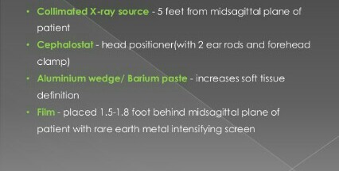
Technical aspects

Slide 10
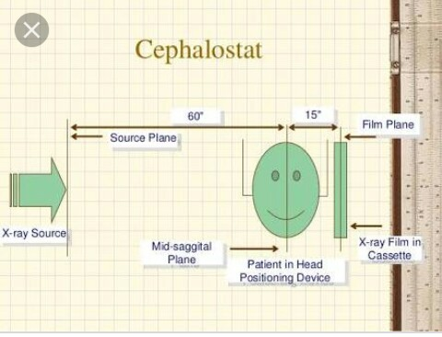

Slide 11
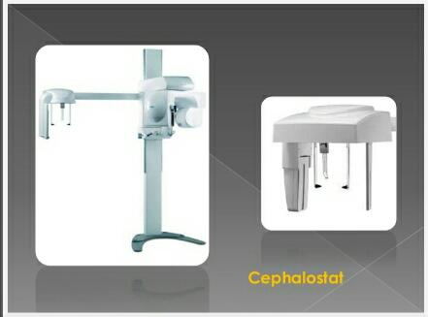

Slide 12
LANDMARKS
CEPHALOMETRICS MAKES USE OF CERTAIN LANDMARKS OR POINTS ON THE SKULL THAT ARE USED TO QUANTITATIVE ANALYSIS AND MEASUREMENTS
THE CEPHALOMETRIC LANDMARKS CAN BE OF TWO TYPES
1) ANATOMIC LANDMARKS: THE LANDMARKS REPRESENT ACTUAL ANATOMIC STRUCTURES OF THE SKULL
2) DERIVED LANDMARKS :THESE ARE LANDMARKS TO HAVE BEEN OBTAINED SECONDARILY FROM ANATOMIC STRUCTURES IN A CEPHALOGRAMS

Slide 13
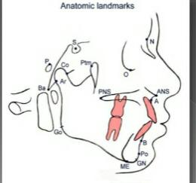

Slide 14
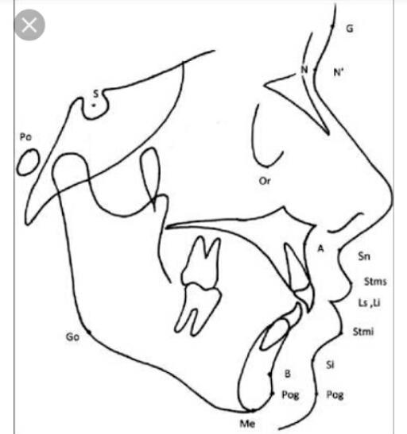
The following are some of the important cephalometric landmarks
1) NASION: the most anterior point Midway between the frontal and nasal bones in the frontonasal suture
2) ORBITALE :The lowest point on the inferior margin of the orbit
3) PORION : the highest point on upper margin of external auditory meatus
4)SELLA: The point representing the midpoint of the pituitary fossa or sella turcica ,it is a constructed point in the mid sagittal plane

Slide 15
5) POINT-A : if is the deepest point in the midline between the anterior nasal spine and alveolar crest between the two central incisors
6)POINT-B : it is the deepest
7)BASION: it is the median point on the anterior margin of foramen magnum
8) BOLTON POINT: the highest point on the post condylar notch of the occipital bone
9) ANTERIOR NASAL SPINE: it is the anterior tip of the sharp bony process of maxilla in the midline of the lower margin of the ANS

Slide 16
10) GONION : it is a constructed point at the junction of the ramus plane and the mandibular plane
11) POGNION: it is the most anterior point of the bony chin in the median plane
12) MENTON: it is the most inferior midline point on the mandibular symphysis

Slide 17
13) ARTICULARE : it is the point at the junction of the posterior border of ramus and the inferior border of the basilar part of the occipital bone
14 ) CONDYLION : the most superior point on the head of the condyle
15 ) POSTERIOR NASAL SPINE: the intersection of a continuation of the anterior wall of the pterygo Palatine fossa and the floor of the nose, marking the distal limit of the maxilla

Slide 18
16 ) GLABELLA : It is the most print point of the forehead in the mid sagital plane
17) SUBNASALE: The point where the lowest border of the nose meets the outer contour of the upper lip

Slide 19
SOFT TISSUE LANDMARKS
The following are the landmarks that can be identified on the soft tissue profile
1) GLABELLA: it is the most prominent point in the mid sagittal plane of forehead
2) NASION SOFT TISSUE: it is the deepest point in the concavity of the soft tissue contour of the root of the nose
3) PRONASALE: the most prominent point of the nose
4) SUBNASALE: it is the intersection of the lower border of the nose and the outer contour of the upper lip
5) LABRALE SUPERIUS: it is the median point of upper margin of the upper membranous lip
6) SUPERIOR LABIAL SULCUS: it is the point on the midline of the upper lip

Slide 20
7) STOMION SUPERIUS: it is the lowest point on the upper lip
8) STOMION INFERIUS: it is highest point on the upper lip
9) STOMION: it is the midpoint between STOMION SUPERIUS and STOMION INFERIUS
10) LABRALE INFERIUS: the median point in the margin of the lower membranous lip
11) POGNION SOFT TISSUE: it is the most prominent point on the soft tissue contour of the chin
12) MENTON SOFT TISSUE : it is a constructed point in the intersection of a vertical coordinate from menton and the inferior soft tissue contour of the chin .

Slide 21
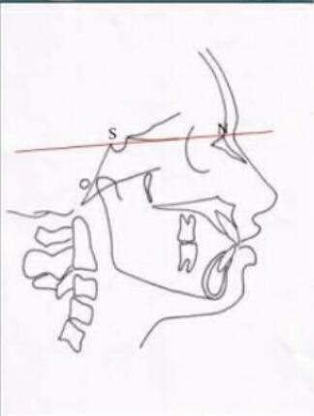
LINES AND PLANES IN CEPHALOMETRICS
BASED ON THE ORIENTATION OF LINES OR PLANES CAN BE CLASSIFIED AS HORIZONTAL AND VERTICAL PLANES.
HORIZONTAL PLANES
1) S.N. PLANES : it is the cranial line between sella and the NASION

Slide 22
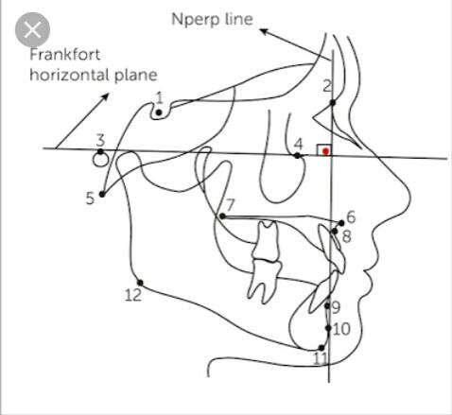
2) Frankfort Horizontal Plane
This plane connects ORBITALE and PORION

Slide 23
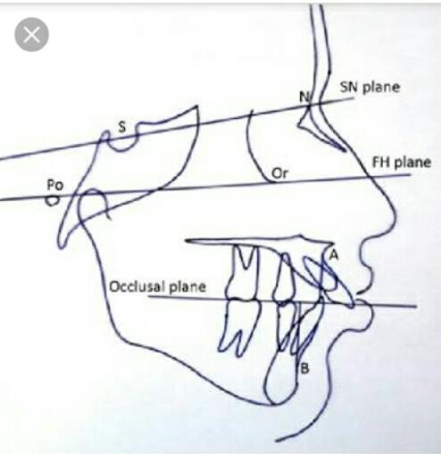
3) Occlusal Plane:
It is the denture bisecting the posterior occlusion of the permanent premolars and molars and extends anteriorly

Slide 24
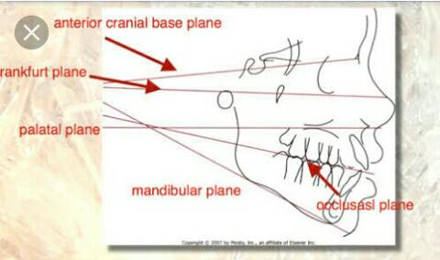
4 ) Palatal Plane
It is the line linking the anterior nasal spine of the maxilla
And the posterior nasal spine of the Palatine bone

Slide 25
5) Mandibular Plane
SEVERAL MANDIBULAR PLANES ARE USED IN CEPHALOMETRICS .THE MOST COMMON USED ONES IS
A)TANGENT TO THE LOWER BORDER OF THE MANDIBLE (TWEED)
B) A LINE CONNECTING GONION AND GNATHION ( STEINER)
C) A LINE CONNECTING GONION AND MENTON ( DOWNS)

Slide 26
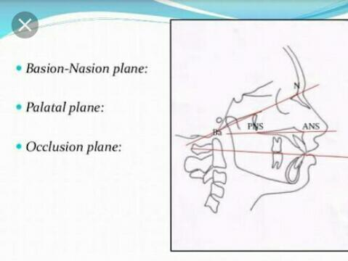
6) BASION – Nasion plane
It is the line connecting the BASION and NASION

Slide 27
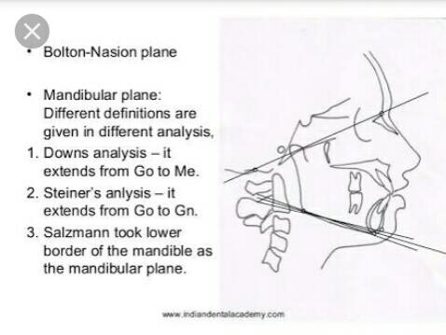
7) BOLTON’S PLANE
This is a plane that connects the Bolton’s point posterior to the occipital condyles and NASION

Slide 28
VERTICAL PLANES
1) A- pog line
It is a line from point A on maxilla to the pogonion on the mandible
2) Facial plane
it is the line from NASION to GNATHION
3) Facial axis
A line from the Ptm to GNATHION
4) E plane
Line between most anterior part of nose and anterior part of chin

Slide 29
SUMMARY
Introduced in 1931 by BROADBENT and HOFRATH
It is a standardized method of production of skull radiographs
Cephalograms can be of two types LATERAL & FRONTAL
It is a valuable tool in the identification and classification of skeletal and dental anomalies

Slide 30
REFERENCES
Textbook of Orthodontics – Gurkeerat Singh, Jaypee Brothers; 2nd Edition
Orthodontics – The Art and Science, S.I Bhalajhi, AryaMedi Publishing; 7th Edition
Textbook of Orthodontics – Sridhar Premkumar, Elsevier; 1st Edition
Orthodontics: Diagnosis and Management of Malocclusion and Dentofacial Deformities – O.P Kharbanda, Elsevier; 1st Edition

Slide 31
Question & Answer Session

